Slide 1
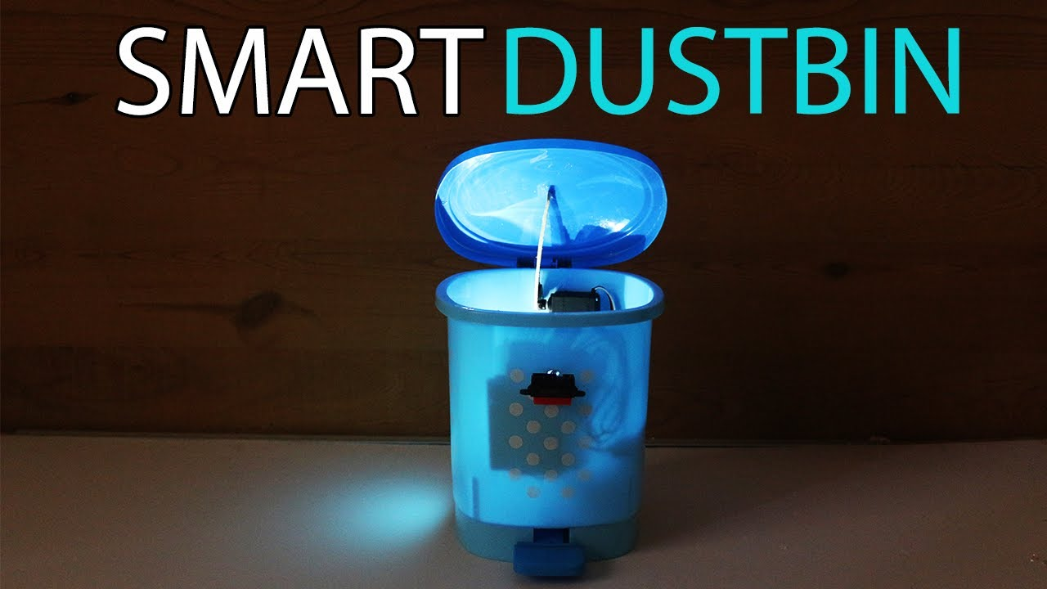
Presented By: Server Monks

Slide 2
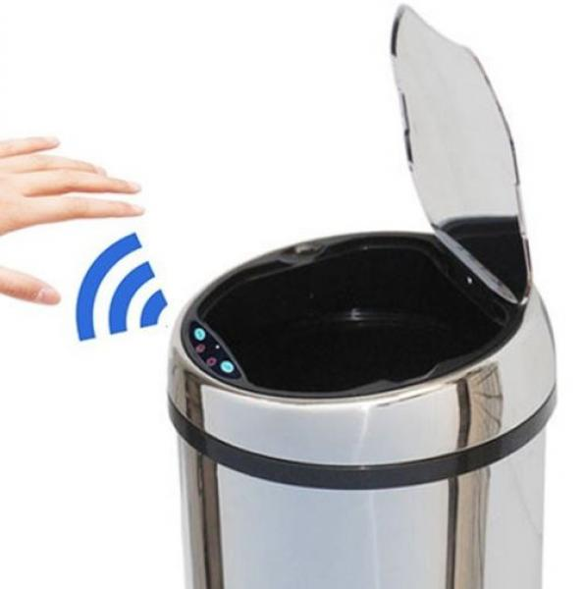
01
What ?
AGENDA
02
Why ?
03
How ?

Slide 3

What ?
Let’s take a look at the idea

Slide 4
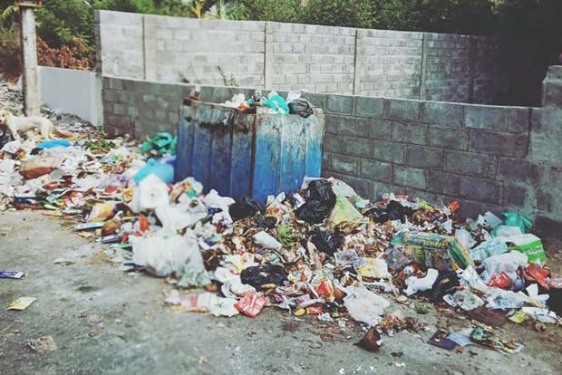


PROBLEM
Why people don’t put garbage in dustbins?
Where is the dustbin?
Dirty dustbin. I don’t want to open it.

Slide 5

AIM
GPS system embedded dustbin help to find near by dustbins
No need to touch the dustbins
Clean and safe surrounded area near dustbins
And much more…………
Garbage monitoring with alert system

Slide 6

Why ?
Let’s discuss the reason behind this initiative

Slide 7
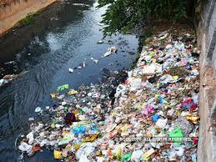
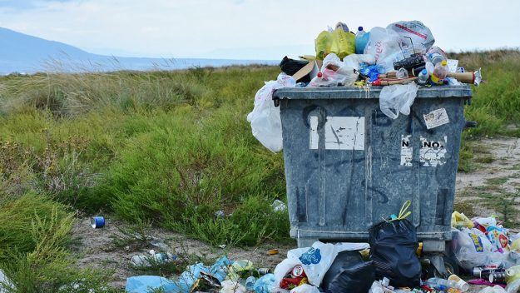
No Dustbin
Dustbin filled

Slide 8
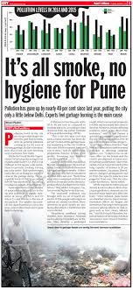
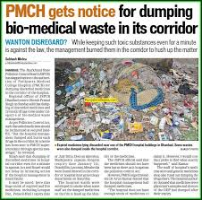
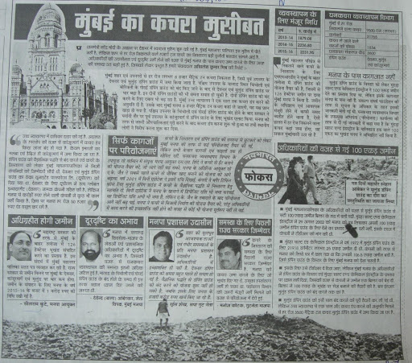
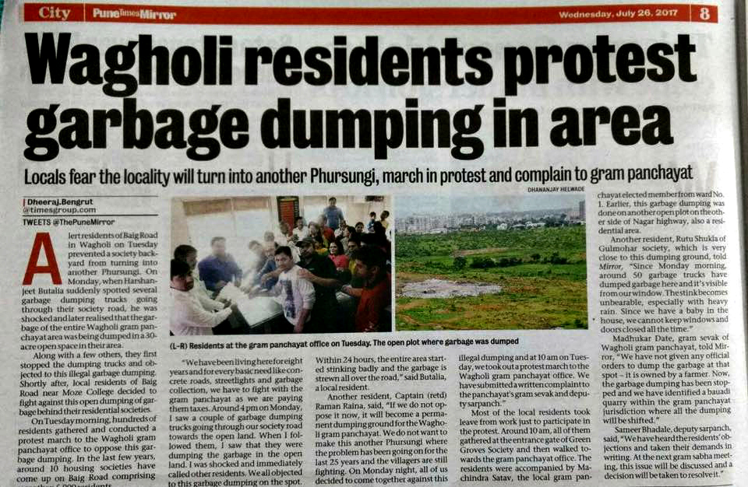
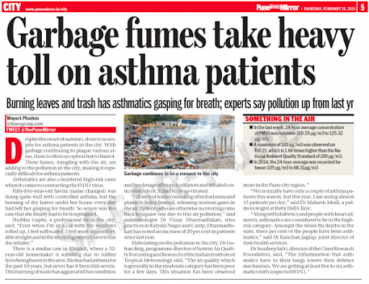
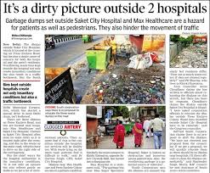
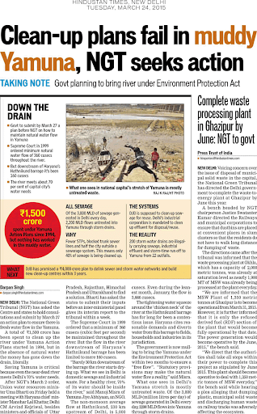
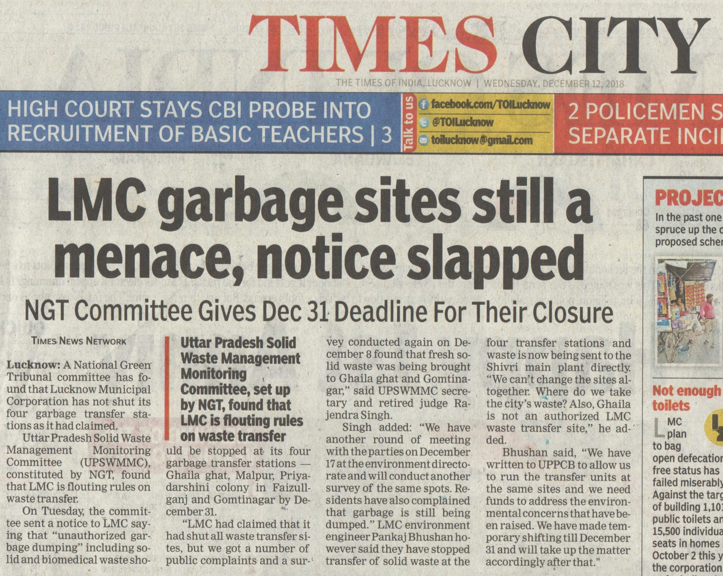
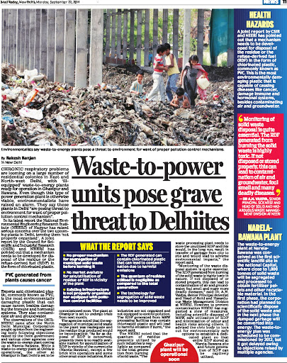
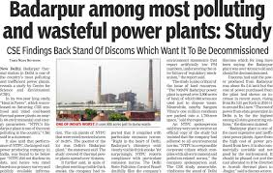
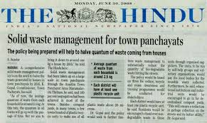
Examples

Slide 9

How ?
Let’s discuss how to implement

Slide 10




Technologies
Internet of things
Cloud computing
Machine learning

Slide 11


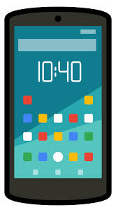


Implementation

Slide 12




Target Customer
Government Sectors
Schools and colleges
Hospitals
Restaurants and Hotels

Slide 13
Application
Empowered Swach Bharat Mission.
2. e-Governance Based on Digital India.
3. Reduce environmental pollution.
4. Real time based cleaning of our cities.
5. It makes our system transparent between Municipal Corporation, Workers and public.

Slide 14
How our model is efficient
Less labour required
This system provides greater accessibility to the dustbin.
It will save fuel and time using appropriate route planning.
We can plan and design the collection process as the data provided by the dustbins.

Slide 15
How we will earn ?
 | EXISTING DUSTBIN | SMART DUSTBIN
Dustbin cost | 500 | 1000
Fuel cost | 400 | 200
Labour cost | 200 | 100
Cost of 1 dustbin for 30 days | 500+(400+200)*30=18500 | 1000+(200+100)*30=10000
Profit on 1 dustbin |  | 8500

Slide 16
Future Scope
Short term:
1) Notification to the nearest waste collection and management department that whether the dustbin has got fully filled up or not.
2) Which is the nearest dustbin , can be known by people in smart cities.
Long Term:
1) Data of the area which has the most collected garbage can be used for a consideration that which is the most populated area, and in which particular time the particular area has so much hustle and bustle.
2) Data selling can be done by companies for the help of government.

Slide 17


